Slide 1
Intro to Quantum Computing
Eric Bond
Spring 2018

Slide 2
Outline
Why quantum?
Theme and variation
Intuitive introduction
Mathematical representation
Programming a quantum computer!

Slide 3
Why?
In Industry..
D-Wave annealer
2011, 128 qubits
2013, 512 qubits
2015, 1000 qubits
2017, 2000 qubits
Universal Gate Model
2016, IBM, 5 qubits
2017, IBM, 17 qubits
2017, Intel. 17 qubits
2017, IBM, 50 qubits
2018, Intel, 50 qubits
3-5-2018, Google, 72 qubits
Topological(‘noise-free’)
2017-2018, Microsoft Station Q, Experimental realizations

Slide 4
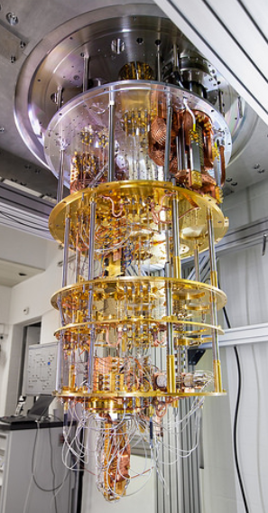
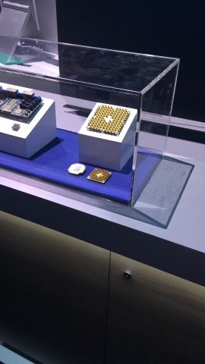
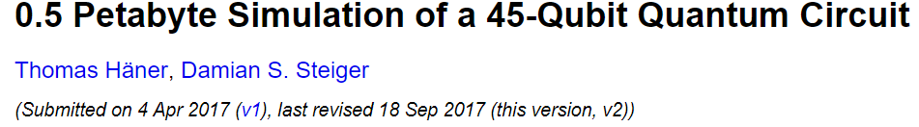
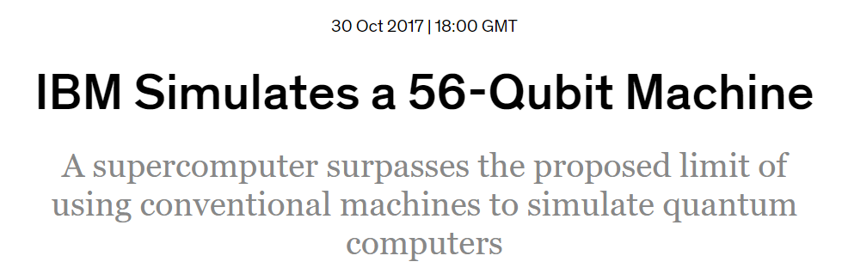
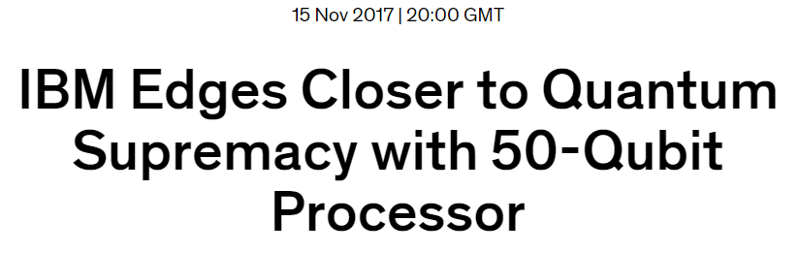
Why?
A race between Classical simulation and Quantum chips
Classical
later that year (down to 3 terrabytes of memory)..
Quantum
IBM QC
Intel 50 qubit chip – CES 2018

Slide 5
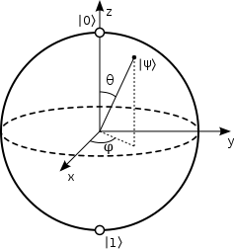

Bit vs Qubit
Bit
State space {0,1}
Can clone
Deterministic measurement
Measurement does not destroy state
Qubit
State space {unit vectors of $ℂ^{2}\}$
Can’t clone
Probabilistic measurement
Measurement destroys state
By Smite-Meister - Own work, CC BY-SA 3.0, https://commons.wikimedia.org/w/index.php?curid=5829358

Slide 6
Mathematically..

Slide 7
Now in code..

Slide 8
Application: Superdense coding

Slide 9
Quantum Information Software Kit
Jupyter notebooks

Slide 10
IBM Quantum Experience

Slide 11
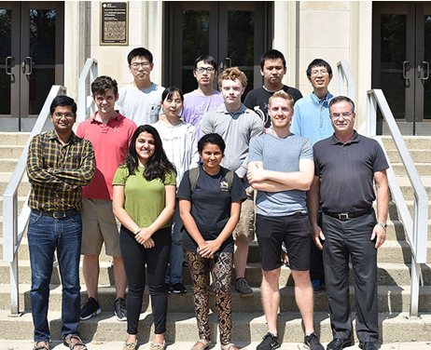
Resources
Active research
https://arxiv.org/archive/quant-ph
List of famous quantum algorithms
https://math.nist.gov/quantum/zoo/
Books
Quantum Computing and Quantum Information
Quantum Computer Science
Quantum programming languages
QASM, Q#, Quipper
Interactive learning
IBM quantum experience, Qskit
Purdue groups
Theory group - https://www.chem.purdue.edu/kais/index.html
Station Q - http://manfragroup.org/

